Slide 1
Question Answering
Generating Snippets and other Single-Document Answers

Slide 2
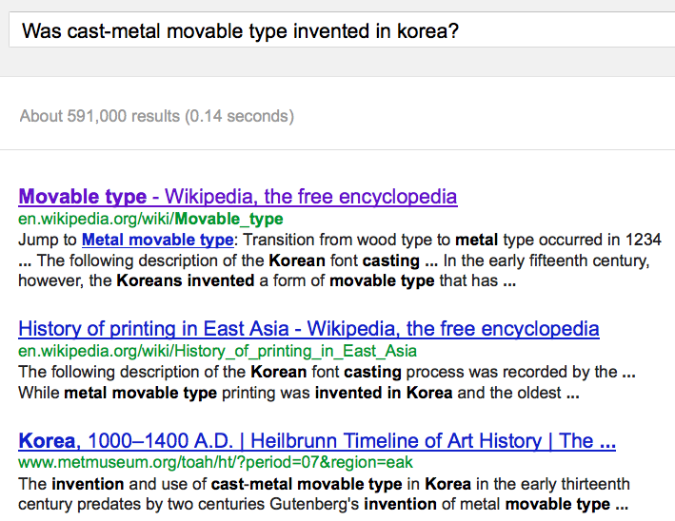
Snippets: query-focused summaries

Slide 3
Summarization: Three Stages
content selection: choose sentences to extract from the document
information ordering: choose an order to place them in the summary
sentence realization: clean up the sentences

Slide 4
Basic Summarization Algorithm
content selection: choose sentences to extract from the document
information ordering: just use document order
sentence realization: keep original sentences

Slide 5
Unsupervised content selection
H. P. Luhn. 1958. The Automatic Creation of Literature Abstracts.
IBM Journal of Research and Development. 2:2, 159-165.
Intuition dating back to Luhn (1958):
Choose sentences that have salient or informative words
Two approaches to defining salient words
tf-idf: weigh each word w_{i} in document j by tf-idf
topic signature: choose a smaller set of salient words
mutual information
log-likelihood ratio (LLR) Dunning (1993), Lin and Hovy (2000)

Slide 6
Topic signature-based content selection with queries
Conroy, Schlesinger, and O’Leary 2006
choose words that are informative either
by log-likelihood ratio (LLR)
or by appearing in the query
Weigh a sentence (or window) by weight of its words:
(could learn more complex weights)

Slide 7
Supervised content selection
Given:
a labeled training set of good summaries for each document
Align:
the sentences in the document with sentences in the summary
Extract features
position (first sentence?)
length of sentence
word informativeness, cue phrases
cohesion
Train
Problems:
hard to get labeled training data
alignment difficult
performance not better than unsupervised algorithms
So in practice:
Unsupervised content selection is more common
a binary classifier (put sentence in summary? yes or no)

Slide 8
Question Answering
Generating Snippets and other Single-Document Answers

